Slide 1

CS6120 Project Proposal:
Identifying and Classifying Toxic Online Behavior
Under Prof. Prashant Mittal
Group F: Ruijia Xiong, Gaurav, Jheel Kamdar, Xiaowen Sun

Slide 2
Agenda:
NLP task & models
What we have done
Challenges so far:
High accuracy for single label prediction, but multilabel accuracy is what we care
LSTM training time: 0.1% -3 min for 1 epoch

Slide 3
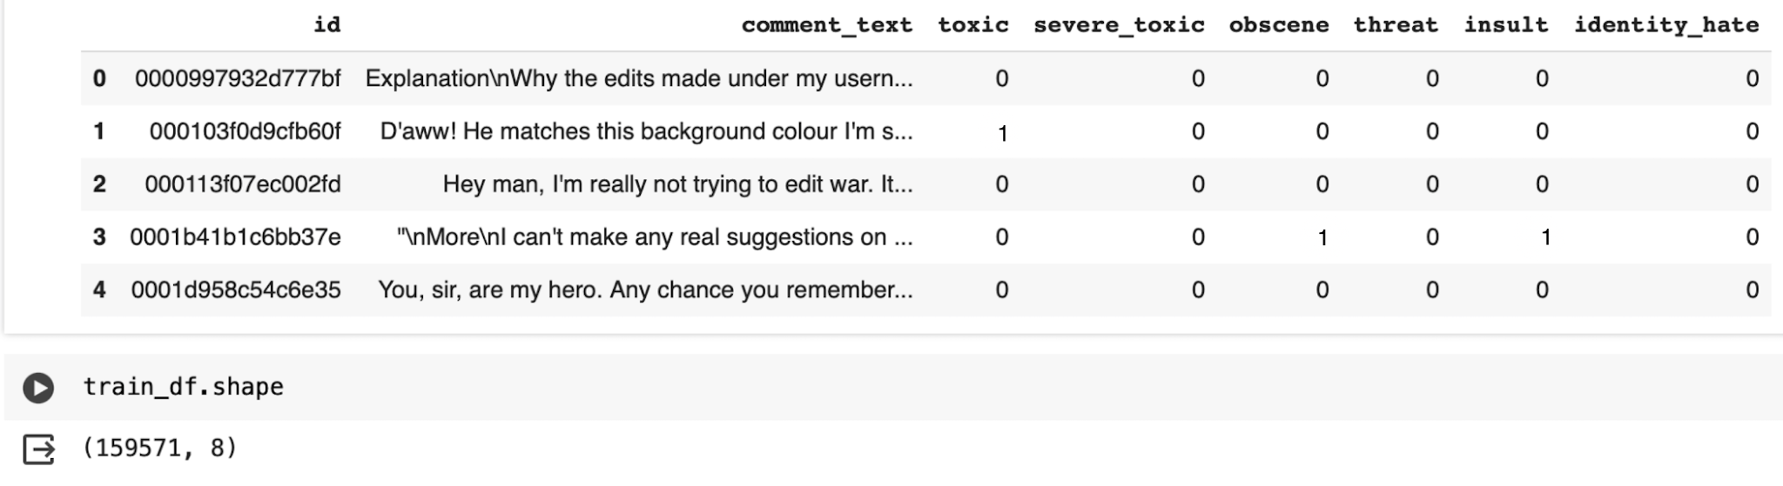
Dataset

Slide 4

What we have done
Dataset of choice: 1% of 160,000
Data Pre-processing: Regex/NLTK, Embeddings- Word2Vec, Visualization - Word cloud
Models we use:
CNN
LSTM
transformer - facebook/bart - zero shot classification
Changes for last feedback
✅Notebook UI ✅
✅Zero-shot classification✅

Slide 5


Slide 6
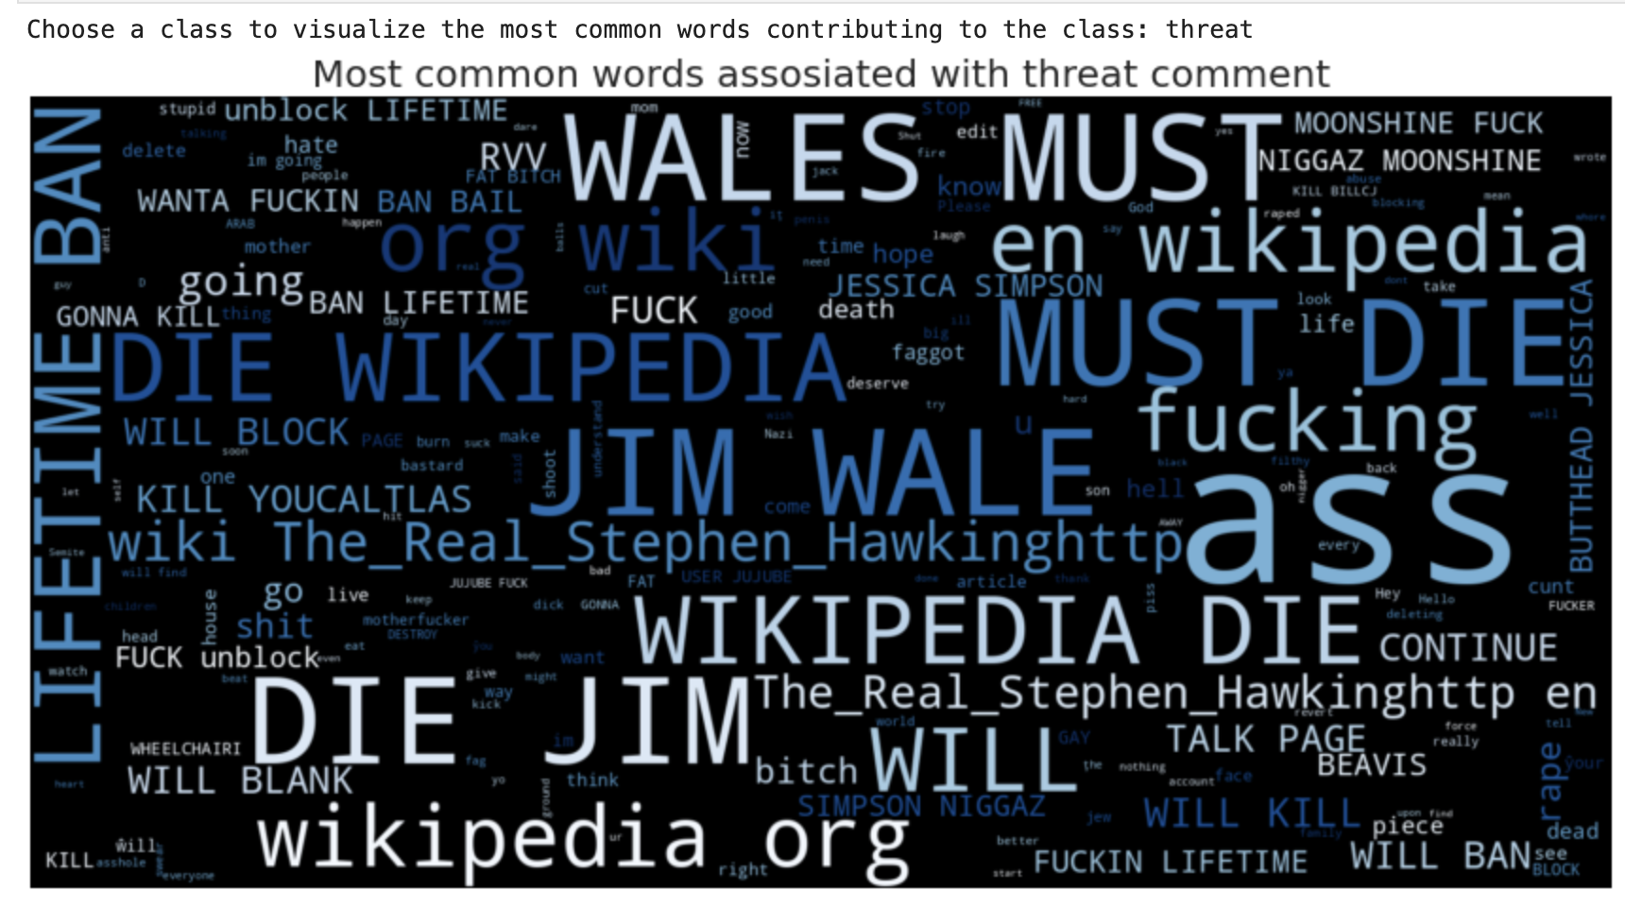
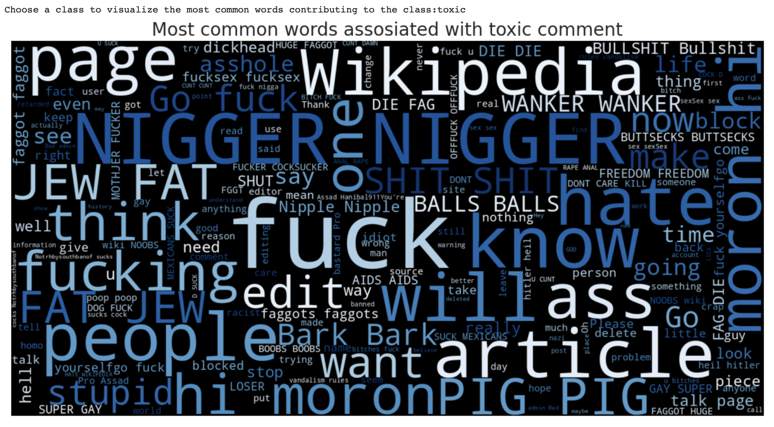
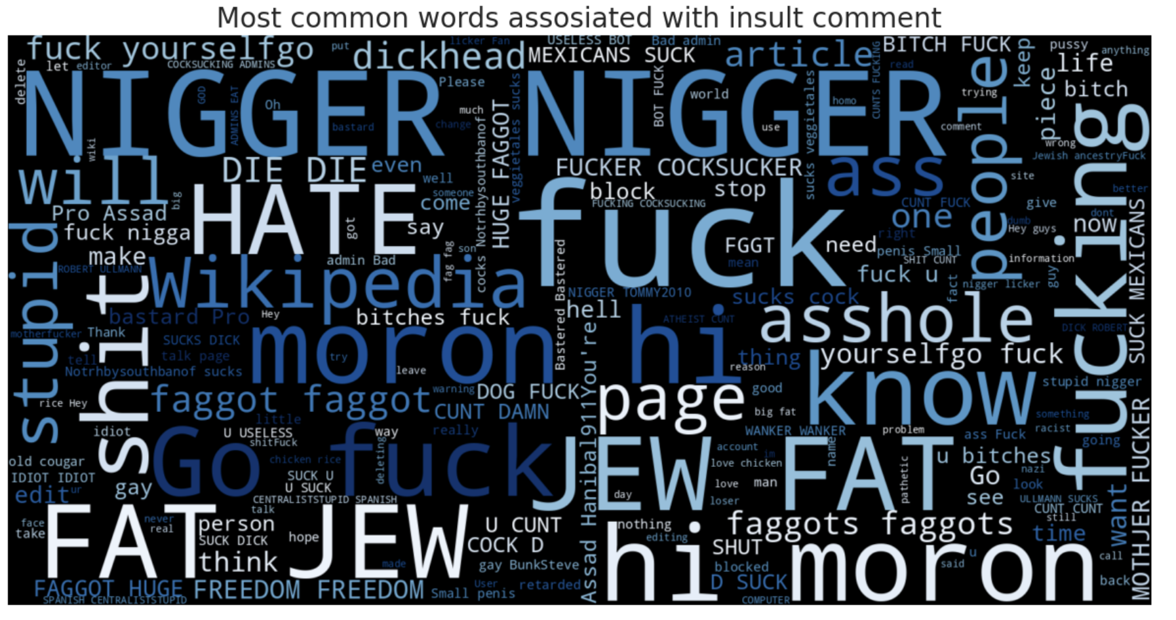
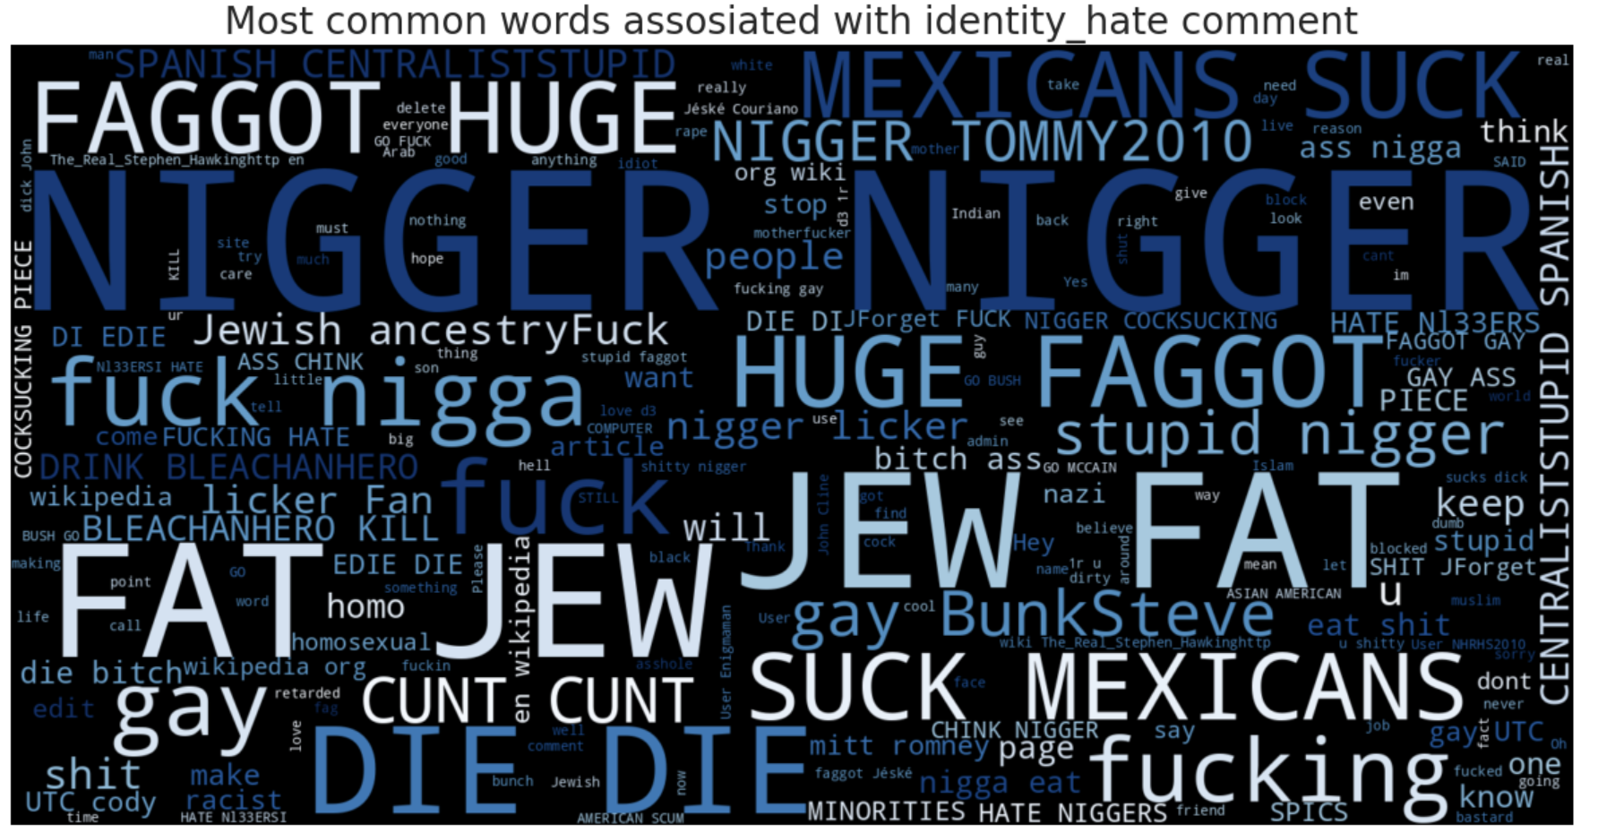
Visualization of the most common words
Threat
Toxic
Insult
Indentity Hate

Slide 7
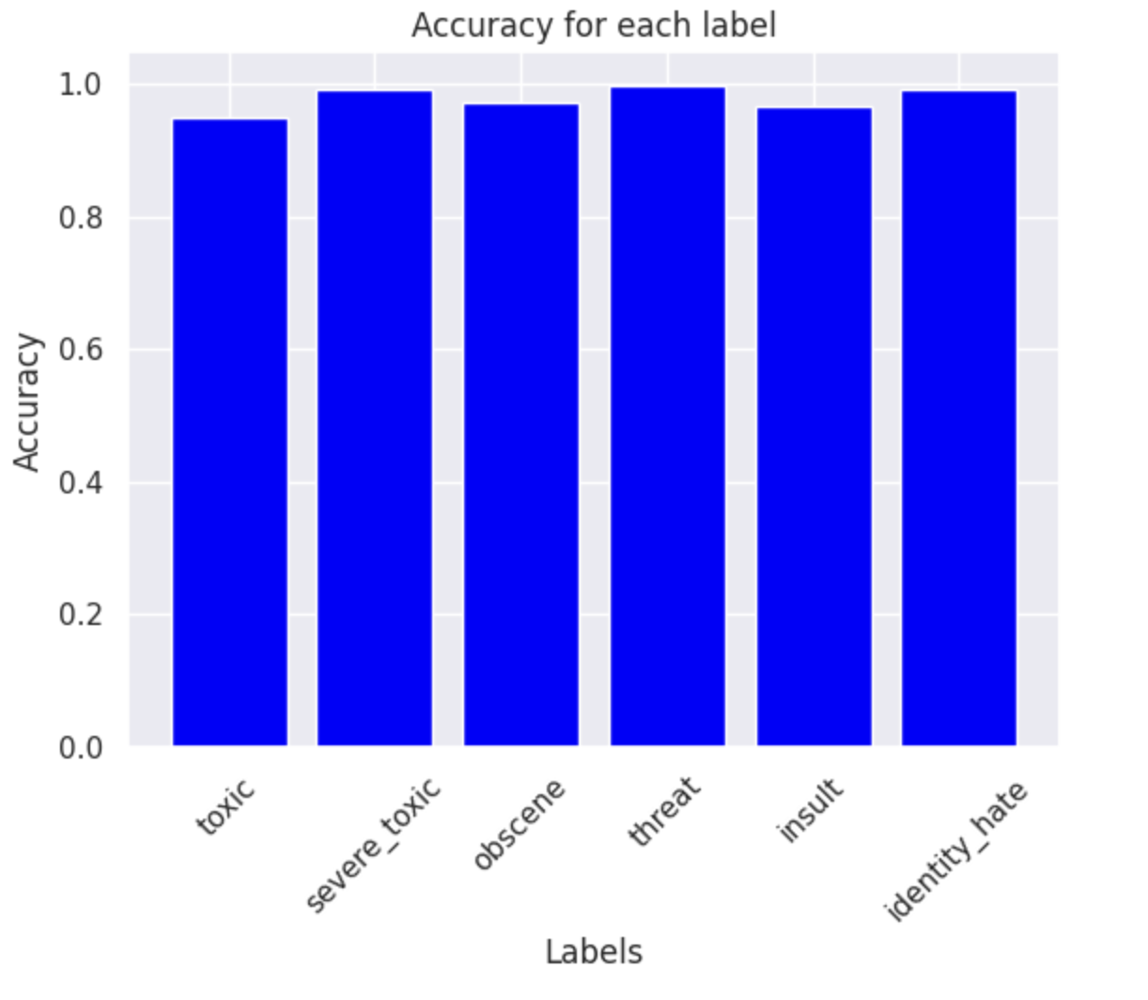
Single class prediction of CNN - high accuracy

Slide 9
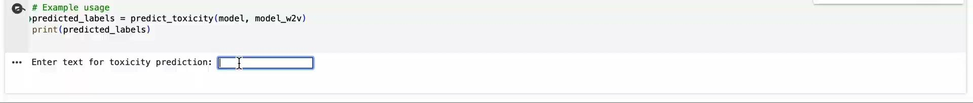
CNN prediction

Slide 10
Plan for next week
Use the whole dataset to train models
Fine-tune the transformer
Try different transformers
Manually set the threshold for the classification according to the softmax scores
Compare the performance of different models/pipelines
Optional:
PCA
Deployment on Hugging Face

Slide 11
Rough Timeline for Week 2
Day | Objective | Task
Day 1 | Initial Model Implementation | - Data preprocessing, finalize model architecture & start model training.
Day 2 - 3 | Model Training & Initial Evaluation | - Continue training, adjust parameters, evaluate with validation subset.
Day 4 | Analysis of Initial Results | - Collect evaluation metrics (accuracy, precision, recall, F1). - Conduct error analysis to identify weaknesses.
Day 5 | Addressing Roadblocks & Refining Model | - Apply changes from error analysis, add data/techniques, re-training/fine-tuning.
Day 6 | Preparing for Progress Update Presentation | - Compile information on implementation, results, challenges, update project timeline.

Slide 12
Thank you

